Slide 1

Proximity Measures
Dr. Umarani Jayaraman
Assistant Professor

Slide 2
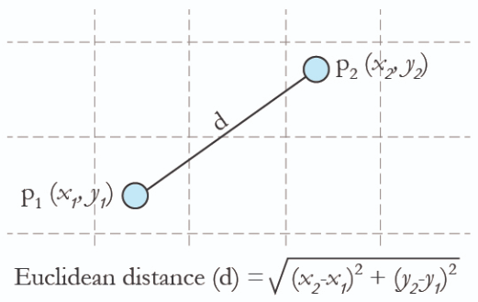
Introduction
Euclidean Distance
To compute the distance between two points
x₂
y₂
x₁
y₁

Slide 3



Why do we need distance measure?
Pattern Recognition
Recognizing similar patterns
Pattern is representation of an object with features/attributes
It is an important aspect of visual perception
How does pattern recognition work?
Training samples
Testing samples

Slide 4
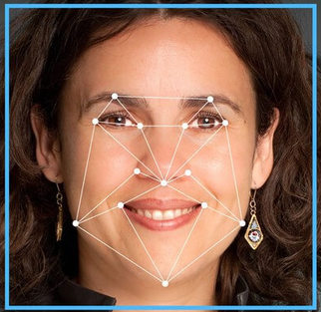
Motivation for distance measure
How does pattern recognition work?
Pattern is represented using features
Feature vector: collection of features
Features
Distance between the eyes
Width of the nose
Length of jaw line
Structure of the cheek
x₁
x₂
x₃
x₄
x₅
y₁
y₂
y₃
y₄
y₅
Compute the distance between these vectors to find similarity

Slide 5
Motivation for distance measure
Why do we need distance measures?
To compare patterns during the task of pattern recognition
Many other applications

Slide 6
d-dimensional feature representation
Feature vectors of dimensionality d representing two patterns
Representation of features of multiple objects
Consider database of N patterns/objects
Each pattern represented using feature vector of dimensionality d
So all the patterns can be collectively represented as a matrix D of size dx N
x₁
x₂
.
.
x_{d}
y₁
y₂
.
.
y_{d}
X =
Y =

Slide 7
d-dimensional feature representation
Database contains N objects
Test Sample
x₁₁ x₁₂ x₁₃ x_{1N}
x₂₁ x₂₂ x₂₃ x_{2N}
. . . .
. . . .
x_{d1} x_{d2} x_{d3} x_{dN}
y₁
y₂
.
.
yd
Y =
dxN
dx1

Slide 8
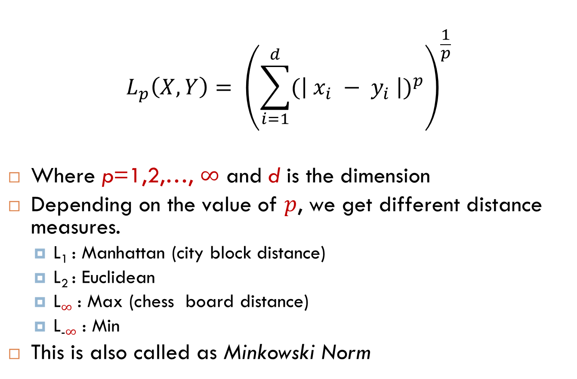
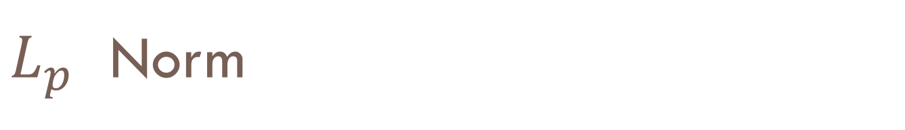
$L_{p}$ Norm
$$L_{p}\left(X,Y\right)= {\left(\sum_{i=1}^{d}{{(\left| x_{i} − y_{i} \right|)}^{p}}\right)}^{\frac{1}{p}}$$
Where p=1,2,…, $∞$ and d is the dimension
Depending on the value of $p$, we get different distance measures.
L₁ : Manhattan (city block distance)
L₂ : Euclidean
L$∞$ : Max (chess board distance)
L₋$∞$ : Min
This is also called as Minkowski Norm

Slide 9
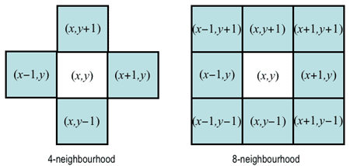
Distance Measures

Slide 10
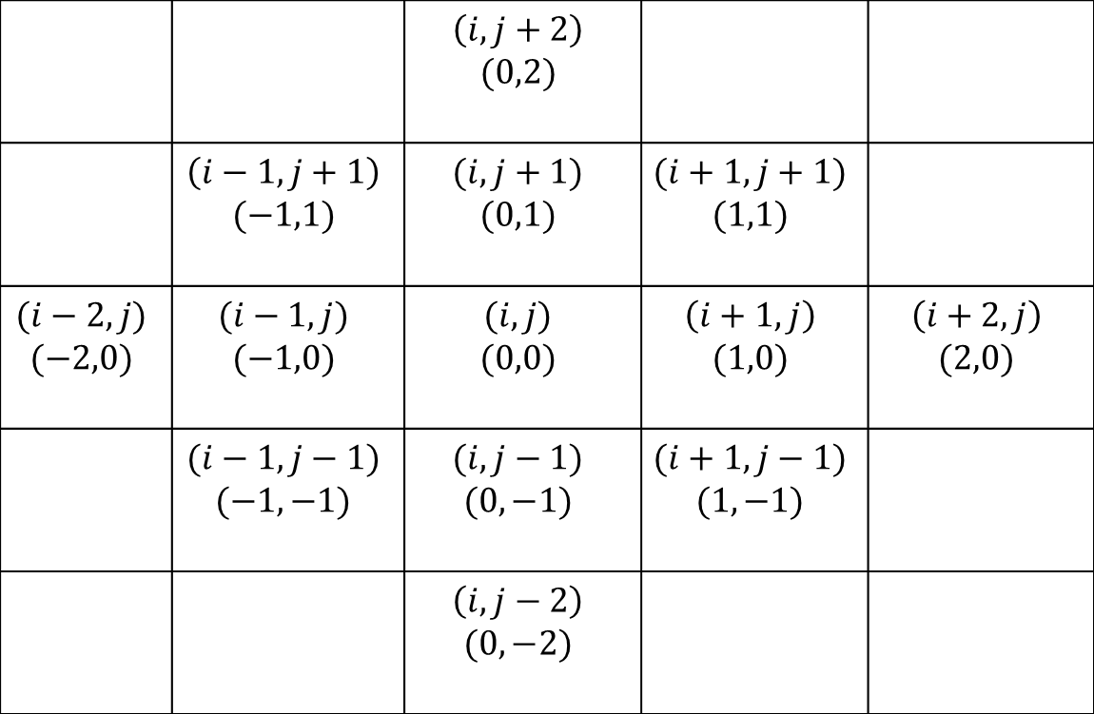
Distance Measures
 |  | $$\left(i,j+2\right)$$ $$(0,2)$$
 | $$\left(i−1,j+1\right)$$ $$(−1,1)$$ | $$(i,j+1)$$ $$(0,1)$$ | $$(i+1,j+1)$$ $$(1,1)$$
$$(i−2,j)$$ $$(−2,0)$$ | $$(i−1,j)$$ $$(−1,0)$$ | $$(i,j)$$ $$(0,0)$$ | $$\left(i+1,j\right)$$ $$(1,0)$$ | $$\left(i+2,j\right)$$ $$(2,0)$$
 | $$(i−1,j−1)$$ $$(−1,−1)$$ | $$(i,j−1)$$ $$(0,−1)$$ | $$(i+1,j−1)$$ $$(1,−1)$$
 |  | $$\left(i,j−2\right)$$ $$(0,−2)$$

Slide 11
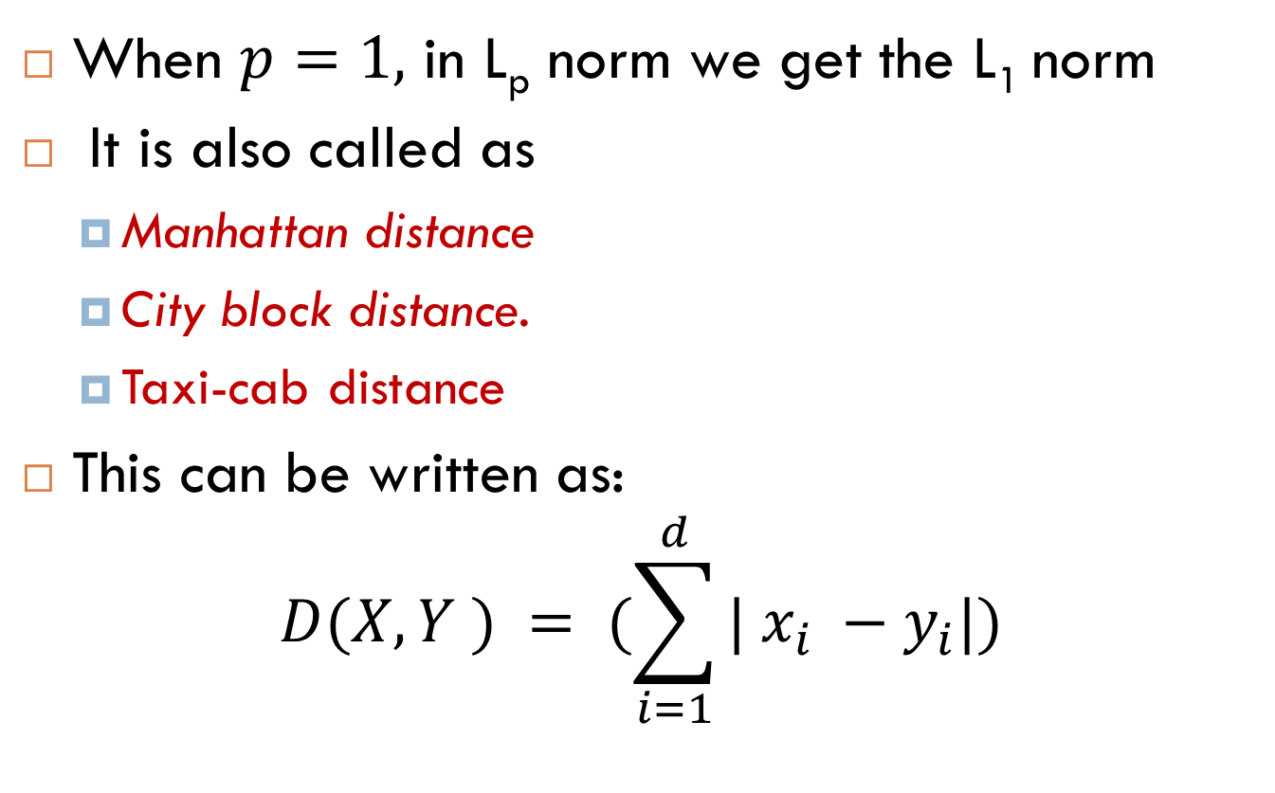

$L_{1}$ Norm/ Manhattan Distance
When $p=1,$ in L_{p} norm we get the L₁ norm
It is also called as
Manhattan distance
City block distance.
Taxi-cab distance
This can be written as:
$$D(X, Y ) = (\sum_{i=1}^{d}{| x_{i} −y_{i}|)}$$

Slide 12
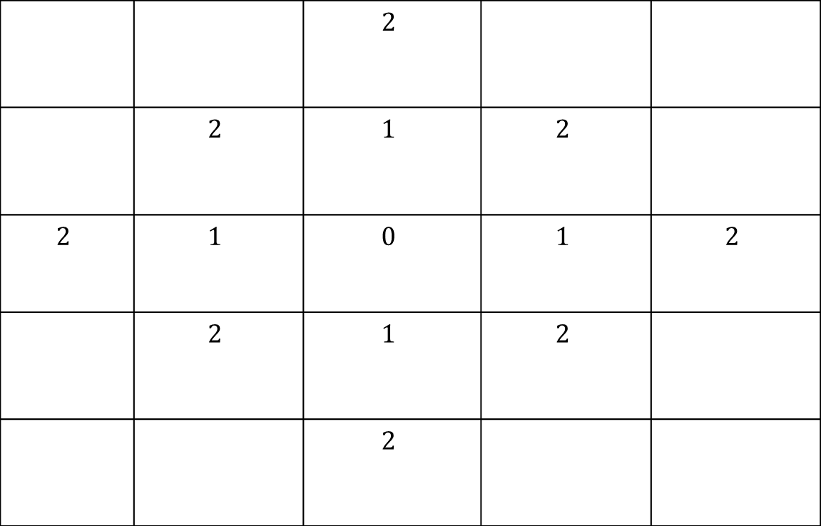
L1 norm called as City Block Distance/ taxi-cab distance: Based on 4-connectivity
 |  | $$2$$
 | $$2$$ | $$1$$ | $$2$$
$$2$$ | $$1$$ | $$0$$ | $$1$$ | $$2$$
 | $$2$$ | $$1$$ | $$2$$
 |  | $$2$$

Slide 13
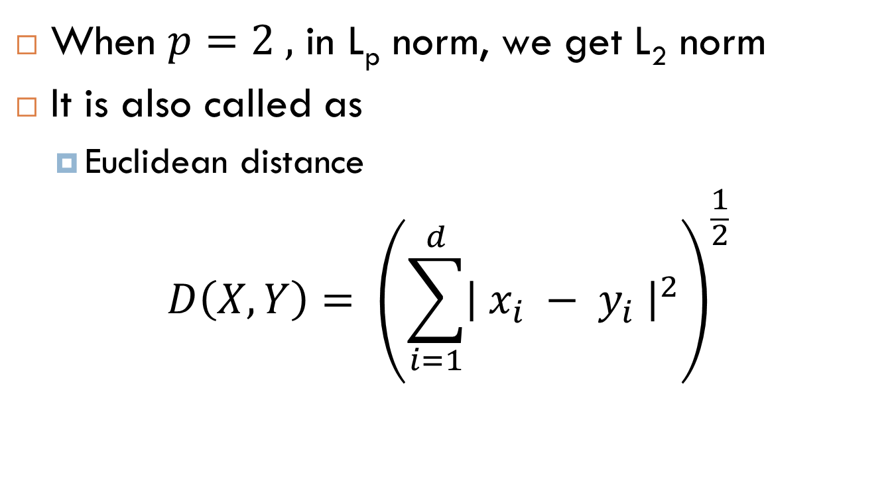
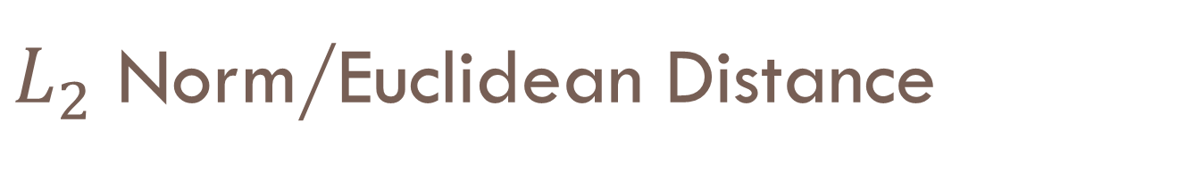
$L_{2}$ Norm/Euclidean Distance
When $p=2 ,$ in L_{p} norm, we get L₂ norm
It is also called as
Euclidean distance
$$D\left(X,Y\right)= {\left(\sum_{i=1}^{d}{{\left| x_{i} − y_{i} \right|}^{2}}\right)}^{\frac{1}{2}}$$

Slide 14
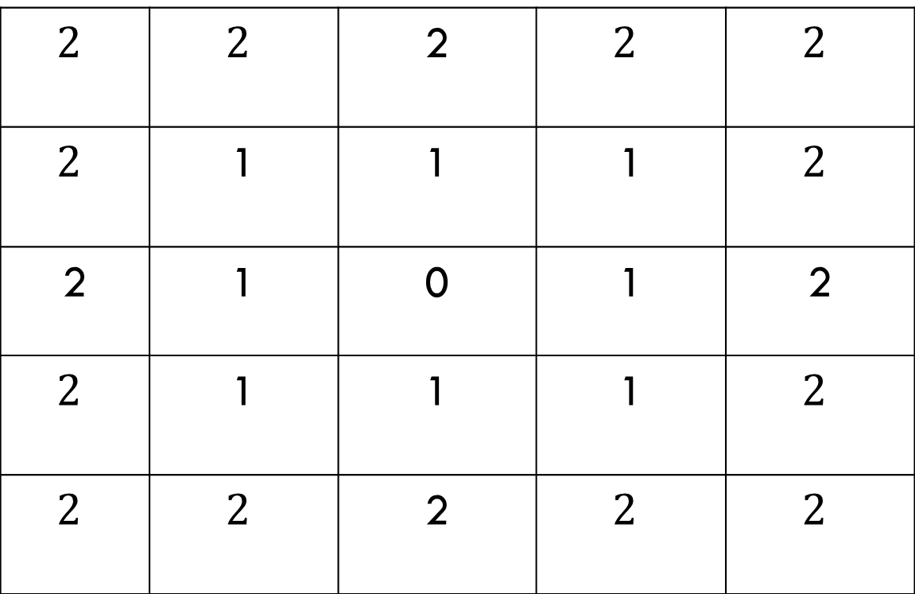
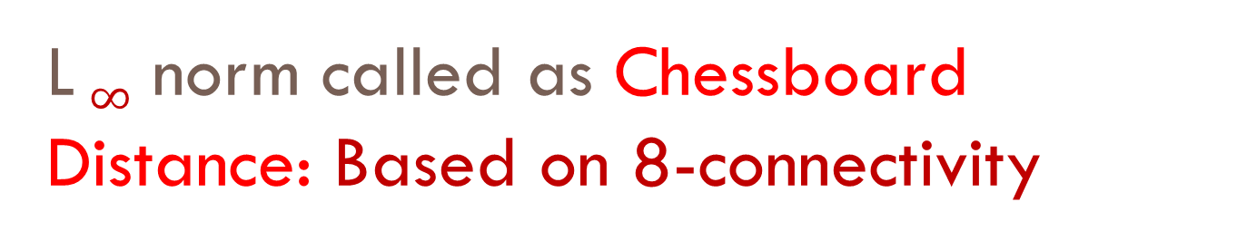
L $∞$ norm called as Chessboard Distance: Based on 8-connectivity
$$2$$ | $$2$$ | 2 | $$2$$ | $$2$$
$$2$$ | 1 | 1 | 1 | $$2$$
2 | 1 | 0 | 1 | 2
$$2$$ | 1 | 1 | 1 | $$2$$
$$2$$ | $$2$$ | 2 | $$2$$ | $$2$$

Slide 15
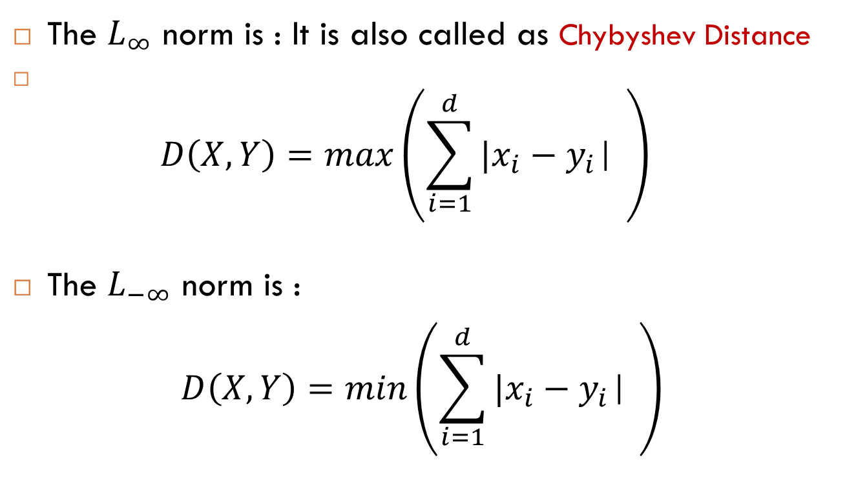

$L_{∞}$ Norm and $L_{−∞}$ Norm
The $L_{∞}$ norm is : It is also called as Chybyshev Distance
$D\left(X,Y\right)=max{\left(\sum_{i=1}^{d}{{|x}_{i}−y_{i}\text{| }}\right)}^{}$
The $L_{−∞}$ norm is :
$$D\left(X,Y\right)=min{\left(\sum_{i=1}^{d}{{|x}_{i}−y_{i}\text{| }}\right)}^{}$$

Slide 16
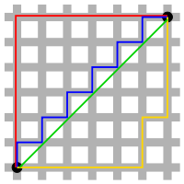
Taxicab or city block distance vs Euclidean Distance
An illustration comparing the taxicab metric to the Euclidean metric on the plane: According to the taxicab metric the red, yellow, and blue paths have the same length which is 12. According to the Euclidean metric, the green path has length 6√2 ≈ 8.49, and is the unique shortest path.

Slide 17
Distance Measures
A distance measure is used to find the similarity between pattern representations.
The distance function could be metric or non-metric.

Slide 18
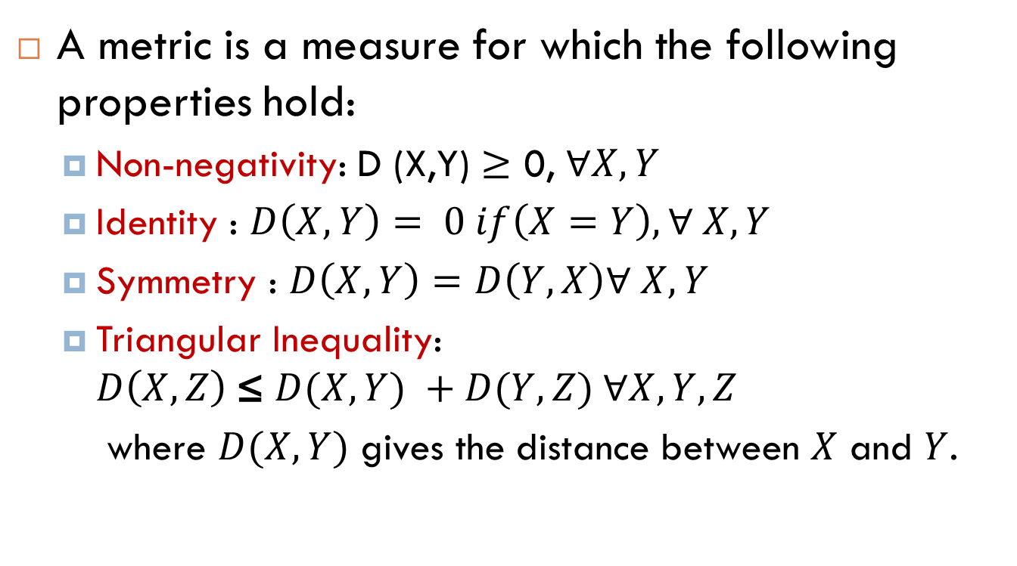
Properties of a Metric Distance
A metric is a measure for which the following properties hold:
Non-negativity: D (X,Y) $≥$ 0, $∀X, Y$
Identity : $D\left(X,Y\right)= 0 if\left(X=Y\right),∀ X, Y$
Symmetry : $D\left(X,Y\right)=D\left(Y,X\right)∀ X, Y$
Triangular Inequality: $D\left(X,Z\right) \text{≤} D(X,Y) +D(Y,Z) ∀X, Y,Z$
where $D(X,Y)$ gives the distance between $X$ and $Y$.

Slide 19
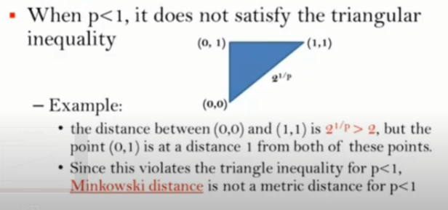


Is $L_{p}$ norm a metric?
Is $L_{p}$ norm a metric?
Yes, $∀ 1≤p≤∞$
No, if p <1

Slide 20

Summary- Metric Similarity Function
Motivation
Minkowski Norm/ $L_{p}$ Norm
Properties of Metric
Euclidean

Slide 21
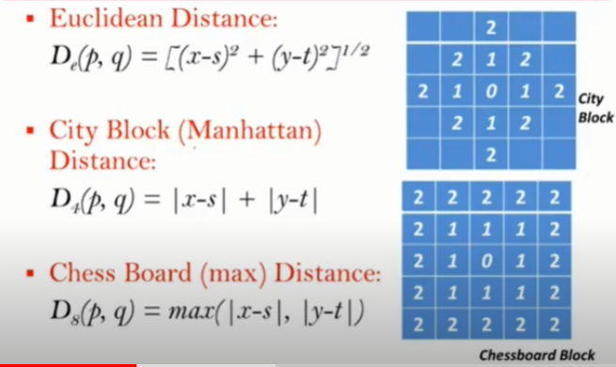
Summary

Slide 22
Thank you

Slide 23
Source-Histogram distance
https://stats.stackexchange.com/questions/7400/how-to-assess-the-similarity-of-two-histograms
https://mpatacchiola.github.io/blog/2016/11/12/the-simplest-classifier-histogram-intersection.html

